Slide 1
CS Ranking Tutorial
2025/06/03

Slide 2
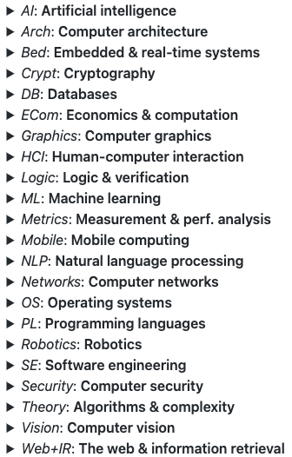
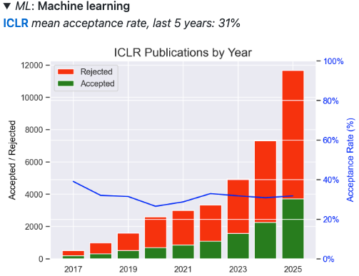
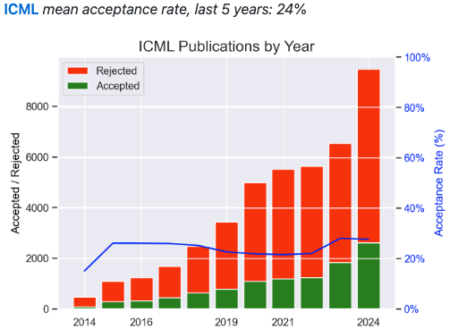
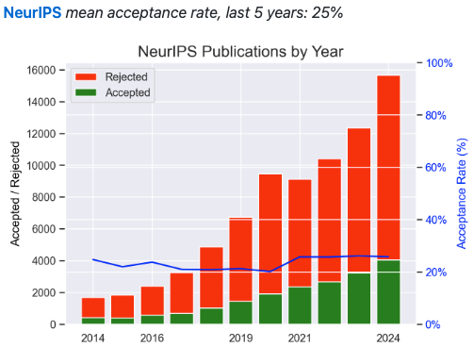
What is CS ranking?
CSRankings is a metrics-based ranking of top computer science institutions (primarily universities) around the world. It based on their publication counts in top-tier conferences and journals, rather than citation counts. The ranking methodology primarily utilizes publication data sourced from DBLP, with an emphasis on quantity (not citation count) of publications in selective areas.
See https://csconferences.org/ for valid CS areas and conferences.

Slide 3
What do we need to do?
To add faculty members to the CSRankings database, contributors must ensure all entries meet the platform's strict eligibility criteria: “Eligible faculty include only full-time, tenure-track faculty members on a given campus who can solely advise PhD students in Computer Science”. Simply speaking, only faculties who are PhD supervisors.
CSRankings requires contributors to submit faculty information in a standardized format: name, affiliation, homepage, scholarid.
name: name in DBLP (if needed, add disambiguation numeric suffixes, e.g., 0001).
affiliation: school and university.
homepage: faculty homepage.
scholarid: google scholar id, i.e., the unique alphanumeric string found in the “user=” parameter of a scholar's profile URL.
Examples:

Slide 4
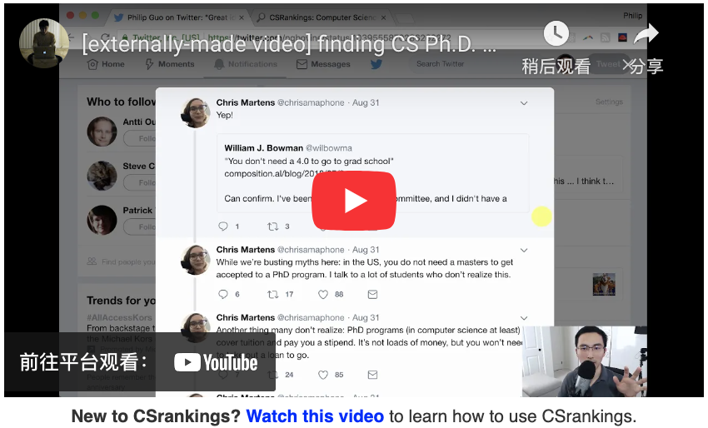
How to record faculty information?
To maintain the accuracy and completeness of CSRankings data, we must:
See https://csrankings.org/ - /index?all&us first for detailed information.
Or you can watch this video https://www.youtube.com/watch?v=hOSl3xPmHiQ&t=231s for the guidance.
Update existing faculty records with current information.
Submit new faculty entries for preciously unlisted researchers.

Slide 5
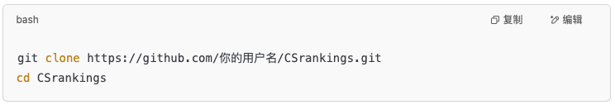
How to record faculty information? – Step 1
Fork the official github repository and clone your forked copy locally.
Open github project address: https://github.com/emeryberger/CSrankings.
Click “Fork” in the upper right corner.
Clone the forked repository locally.

Slide 6
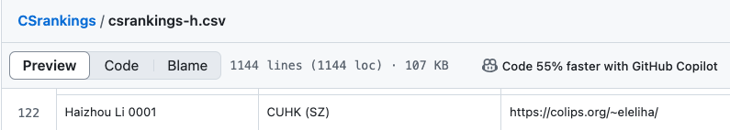
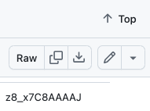
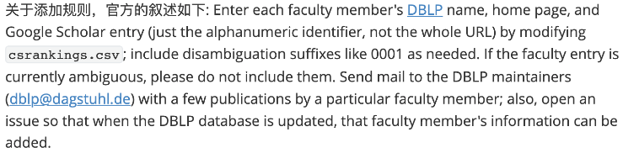
How to record faculty information? – Step 2
Modify or add faculty information.
Read carefully https://github.com/emeryberger/CSrankings/blob/gh-pages/CONTRIBUTING.md. This is the official guidance.
You only need to modify the csv files csrankings-[a-z].csv to contain the professor/faculty information and institution information of the corresponding first letter.
Official guidance is given by:

Slide 7
How to record faculty information? – Step 3
Notes on modification.
Don't use EXCEL to modify the csv files, use editor like Notepad.
Do not add a space after the comma.
When adding information to csrankings-[a-z].csv, add it in alphabetical order, not at the end. You can use a script to sort and rewrite each line of text after adding it.
If there are multiple entries for professor/faculty information on the DBLP website https://dblp.org/ you need to add the corresponding number. (If you are not sure, the official recommendation is to contact DBLP, or you can contact the corresponding professor/faculty to complete the information in DBLP).
When adding a homepage, you need to make sure it can be opened and use a complete http link.
Note that professor/faculty need to be reminded to update their DBLP or clarify their DBLP in advance.

Slide 8
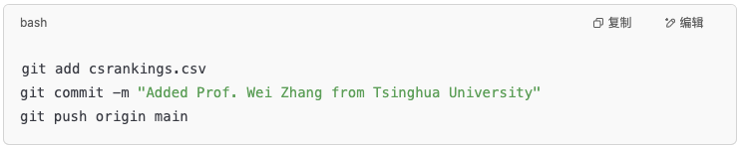
How to record faculty information? – Step 4
After all information is modified locally, push the changes to github. The commit information needs to clearly state the purpose of the modification.

Slide 9
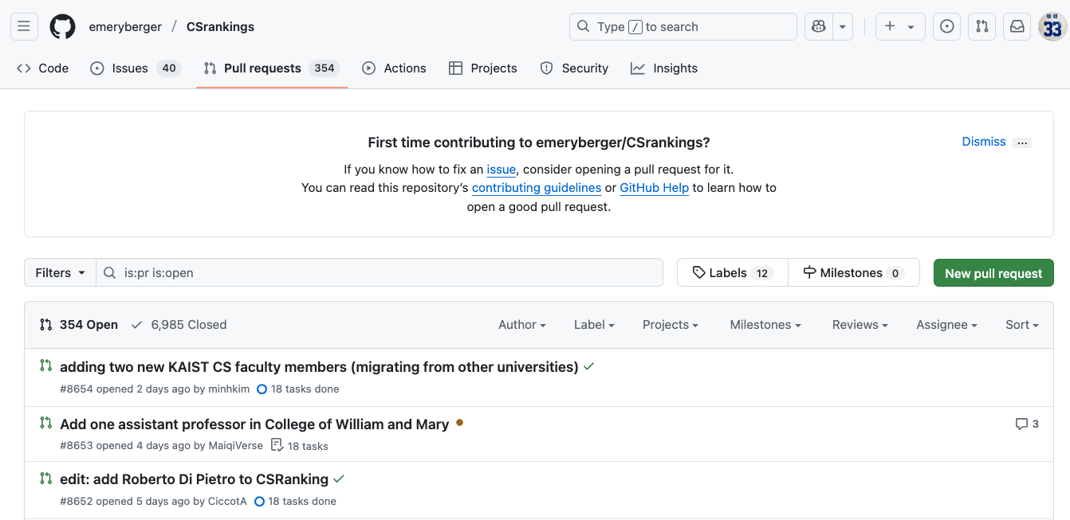
How to record faculty information? – Step 5
After confirming the modification, you can submit PR (Pull Request) on the github https://github.com/emeryberger/CSrankings. All PR confirmation information must be confirmed and checked.
Open GitHub, go to your Fork page, and click “Compare & pull request”
In the PR description, specify: add the professor/faculty, his/her DBLP link, and the time of joining (to confirm whether the statistics of his/her achievements are reasonable)

Slide 10
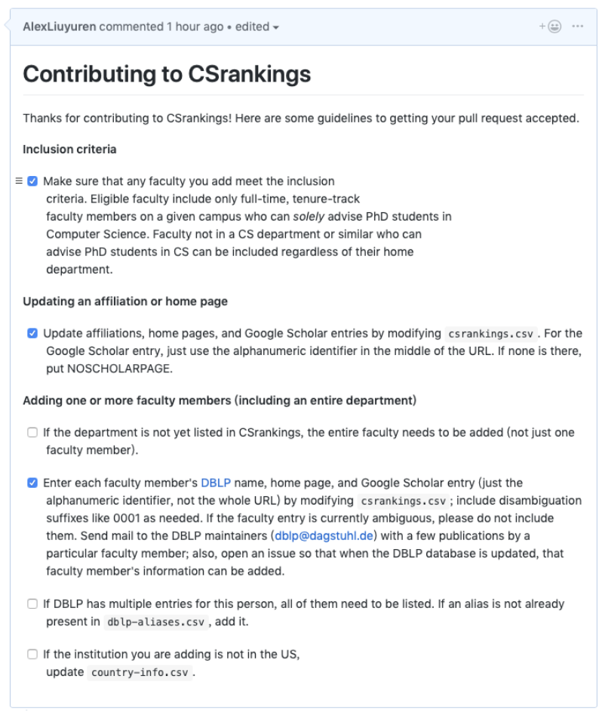
How to record faculty information? – Step 5
After confirming the modification, you can submit PR (Pull Request) on the github https://github.com/emeryberger/CSrankings. All PR confirmation information must be confirmed and checked.
PR needs to check the corresponding content according to the CSRanking template (in markdown, just add x in the square brackets, e.g. [x]), as follows:

Slide 11
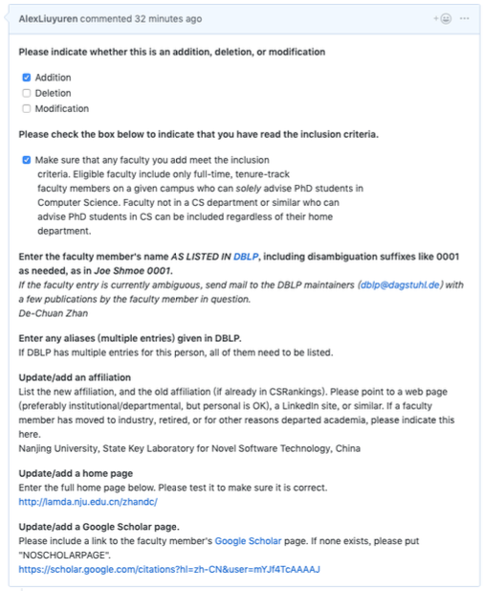
How to record faculty information? – Step 5
After confirming the modification, you can submit PR (Pull Request) on the github https://github.com/emeryberger/CSrankings. All PR confirmation information must be confirmed and checked.
When modifying csrankings-[a-z].csv, you can add multiple professors/faculties at a time, but you can only add/modify one faculty per issue. Adding an issue is easy, just fill it out according to the template provided by csranking website.

Slide 12
How to record faculty information? – Step 6
Wait and pay attention.
After submitting a PR, you can contact the professor/faculty to send an email to csrankings, stating the PR ID and other information to indicate that it has been submitted; after receiving the PR, the official will review and give a result, which requires timely attention and reply.
Generally speaking, adding CS ranking faculty requires two phases. The first one is modifying the csrankings-[a-z].csv file, add relevant entries and submit a pull request. The second one is submitting an issue for each added faculty member.
Please aware about the new instruction in the official guidance: https://github.com/emeryberger/CSrankings/blob/gh-pages/CONTRIBUTING.md
The CSRanking official will merge the information every 2-3 months. You can double check the ranking after they merge the information.

Slide 13
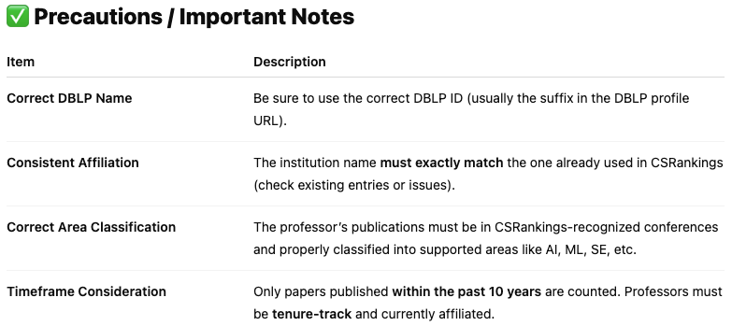
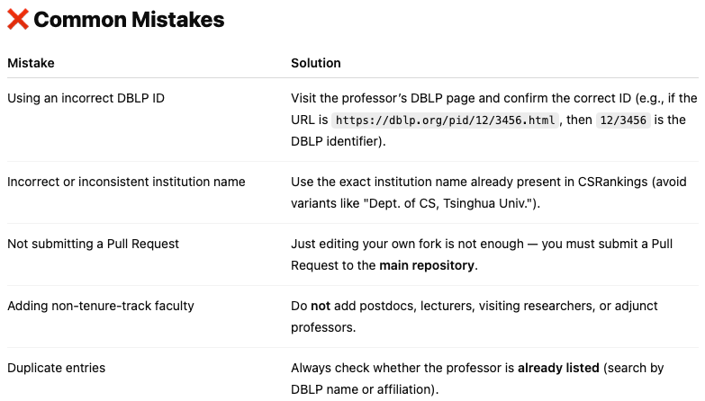
⚠️ Notes and common mistakes

Slide 14
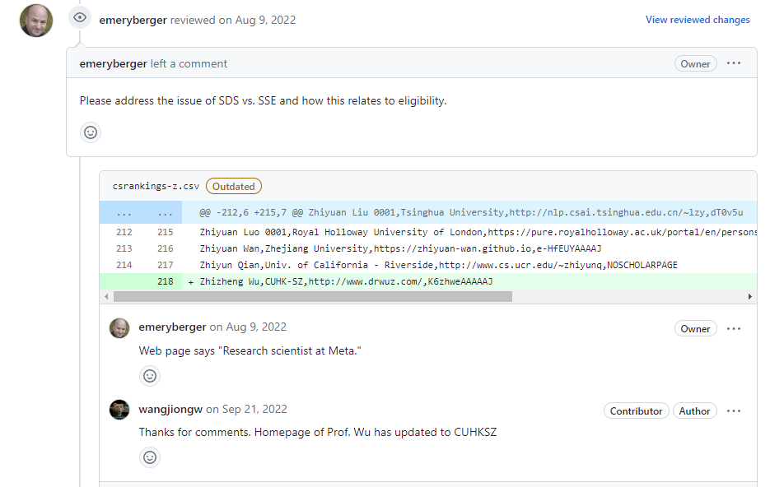
🙋 Frequently asked questions – Q1
Q1: The professor or faculty homepage information is not aligned.

Slide 15
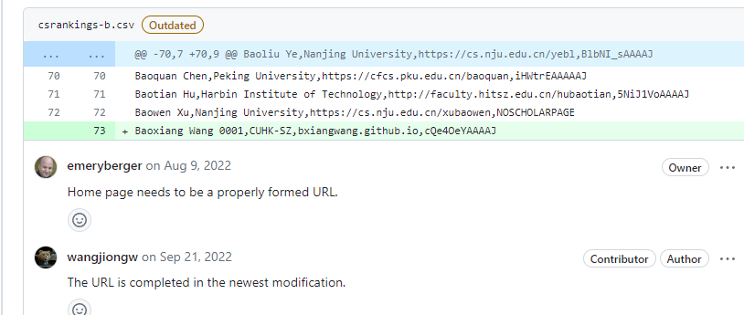
🙋 Frequently asked questions – Q2
Q2: Need to use the full github homepage link for professor or faculty.

Slide 16
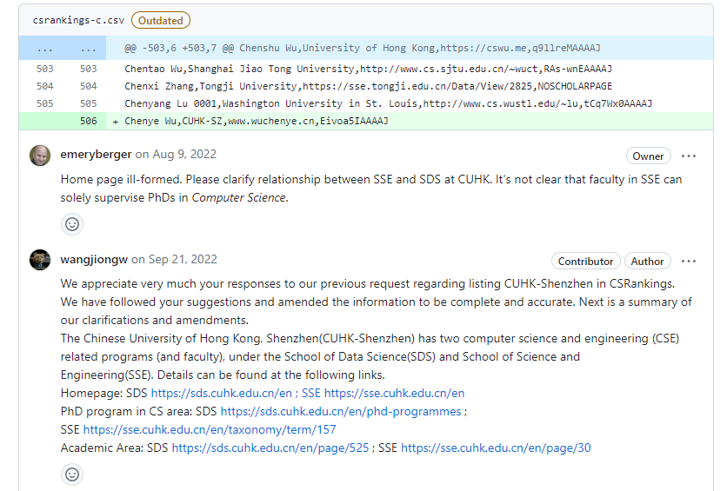
🙋 Frequently asked questions – Q3
Q3: The relationship between the professor/faculty’s homepage and the institution/school is not clearly explained.

Slide 17
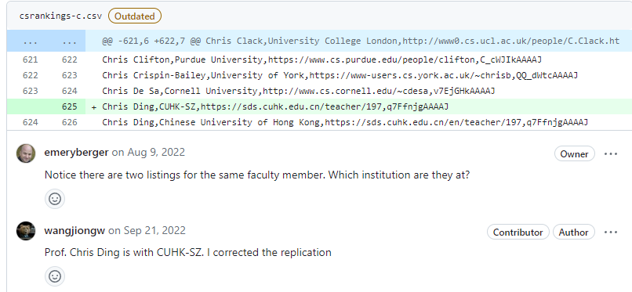
🙋 Frequently asked questions – Q4
Q4: If the professor/faculty information is already in CSRankings, to modify the existing professor/faculty information, you need to delete the original information to update it, and it cannot be repeated.

Slide 18
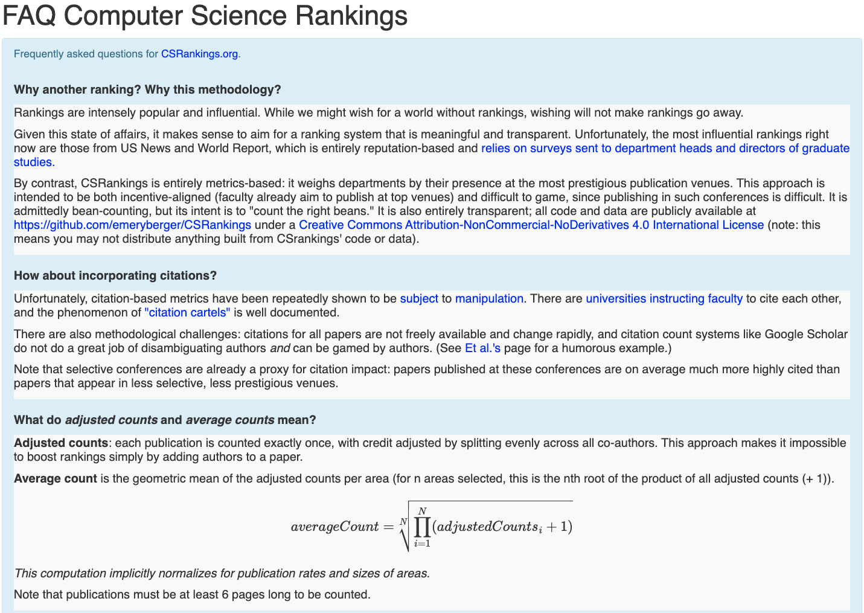
🙋 Frequently asked questions – More FAQ
More FAQs can be found in the official website https://csrankings.org/faq.html

Slide 19
Thanks！

